Slide 1
Fujitsu demo
3 June, 2019
Takahisa Suzuki, Ryuichi Matsukura
Fujitsu Laboratories Limited.
(suzuki.takahisa@fujitsu.com)

Slide 2
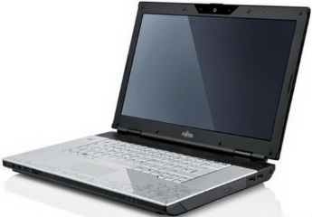
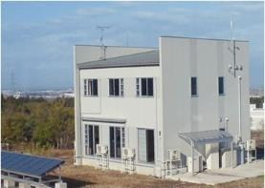
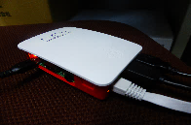

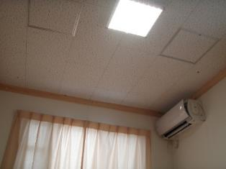
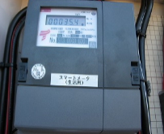


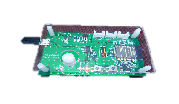

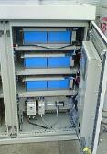

Fujitsu’s demo system
Demo application
(Munich)
Smart house (Japan)
Remote Proxy
(Japan)
Workshop site (Munich)
Local Proxy
Local Proxy
Smart meter
BLE
USB
WiFi
EtherCAT
Buzzer
Beacon Light
Environment
Sensor
Blind, Light,
Air conditioner
Agriculture Sensor,
Wearable Sensor
Storage battery

Slide 3
Device virtualization technology
Gateway
Application
READ
Virtual device
Propriety Interface
Physical Device
WoT
WRITE
Property | Value
Status | ON
Mode | Cooling
Temperature | 27
NOTIFY
Application
WoT interface
Applications can handle devices through WoT inteface
Virtual A
Virtual B
Virtual C
Gateway
Adapter
Adapter
Device A
Device B
Device C

Slide 4





Connecting many kinds of devices by WoT
Application
Virtual devices on cloud gateway
A
B
C
D
E
F
Gateway (cloud)
Virtual A
Virtual B
Virtual C
Virtual D
Virtual E
Virtual F
Gateway (local)
Gateway (local)
BLE
Adapber
USB
Adapter
ECHONET Lite
Adapter
BLE
USB
LED, Window blind, Air conditioner
Storage battery
Smart meter

Slide 5
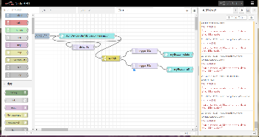
Scenario 1: Environment monitoring
Monitors and controls many kinds of devices by WoT
Application
Monitor & Control
Workshop site (Munich)
Remote Proxy
Smart house (Japan)
Local Proxy
Local Proxy
Smart meter
WiFi
BLE
USB
EtherCAT
Buzzer
Beacon Light
Environment
Sensor
Agriculture Sensor,
Wearable Sensor
Blind, Light,
Air conditioner
Storage battery

Slide 6
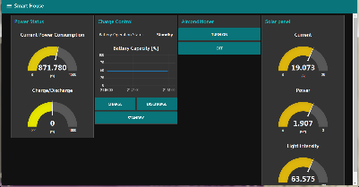
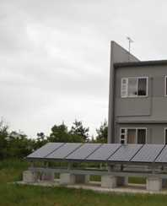
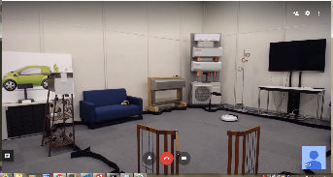
Scenario 2: Energy management
Enhancing power efficiency for smart home
Application
Control devices
Monitor state
Solar panel
Smart house (Japan)
Oracle (Simulator)
Remote Proxy
(Japan)
Local Proxy
Smart meter
Home appliances
Panasonic
Blind, Light,
Air conditioner
Storage battery

